Slide 1

Revenue Prediction for Airbnb Host for next quarter
Kavyasri Jadala, Vineeth Pydi, Abhishek Krovvidi, Avishek Dasgupta

Slide 2





Our Team

Slide 3
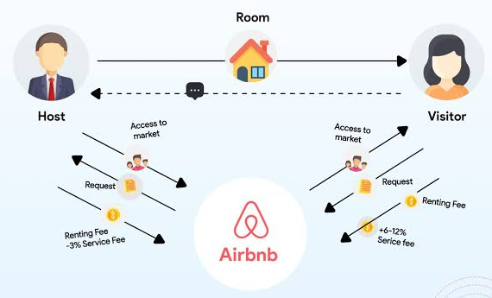
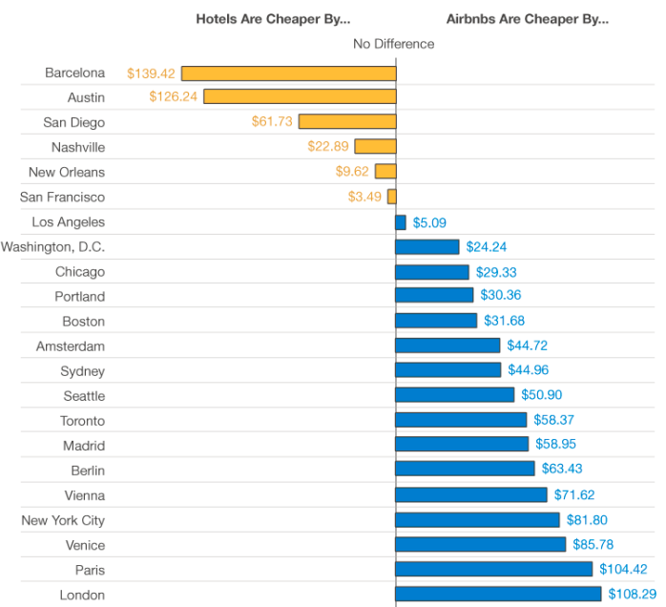
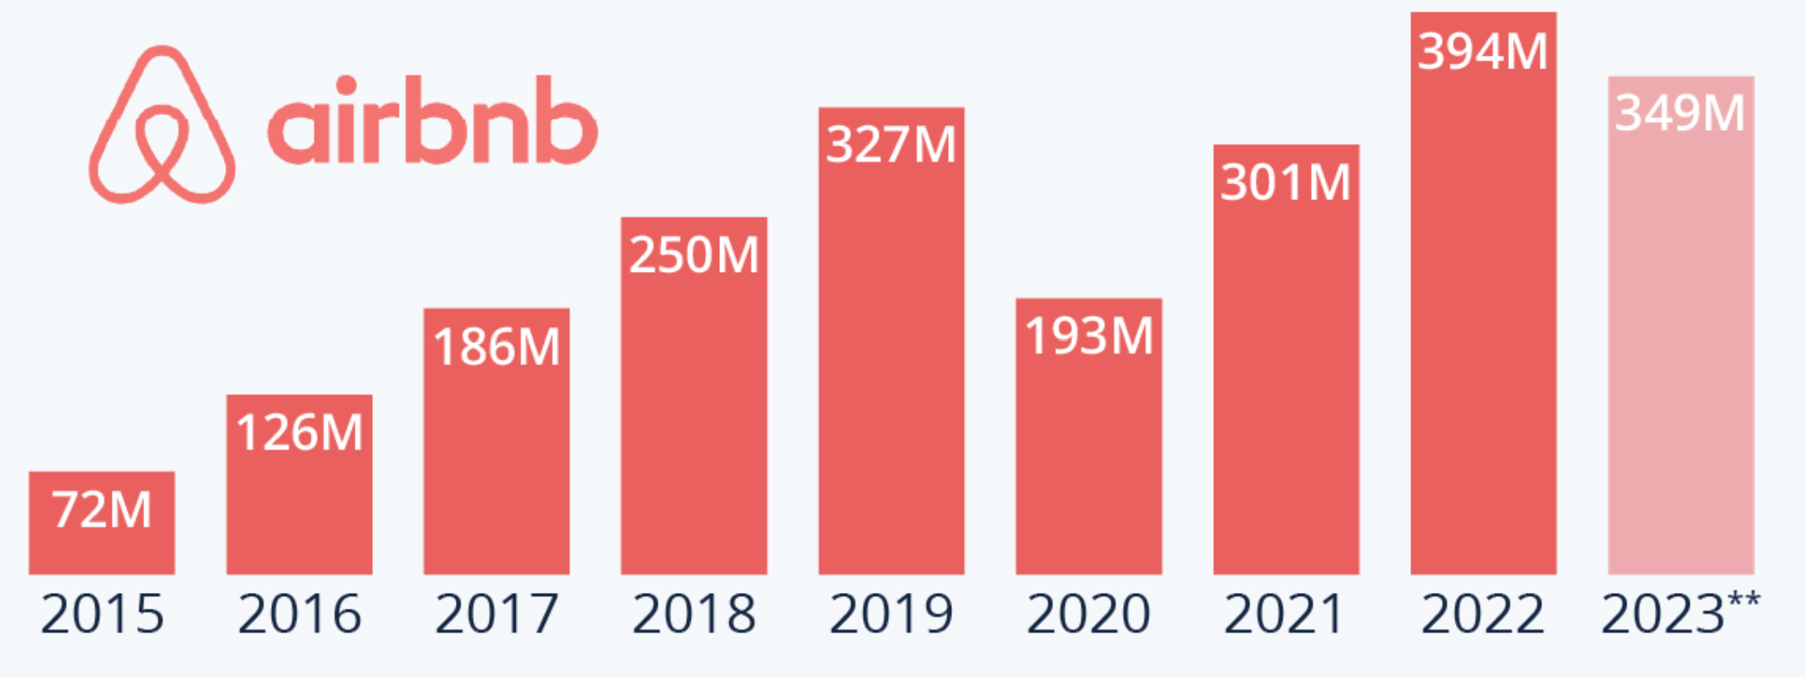
Airbnb Business Model
Motto:
"Belong Anywhere"
Affordable and safe community
Airbnb Business Model:
Two-Sided Marketplace
Owners List
Guest Book
Revenue Streams
Service Fees
Diverse Streams
Competition:
Booking.com
Vrbo
Airbnb Business Model
Airbnb Market Growth over Years
Comparative Cost of Airbnb over others
Source: https://bmtoolbox.net/stories/airbnb/, AirBnb,
https://www.busbud.com/blog/airbnb-vs-hotel-rates/
Notes:
In the dynamic world of vacation rentals, Airbnb stands out with its innovative two-sided marketplace. By connecting property owners and guests, Airbnb has reshaped travel experiences globally. The business model, driven by service fees and diverse revenue streams, has fueled its success. For property owners, Airbnb simplifies the process, of handling bookings, payments, and offering additional services. In a competitive landscape, Airbnb faces formidable rivals like Booking.com and Vrbo. To thrive as hosts, it's crucial to price competitively, optimize listings, offer extra services, and prioritize customer service. As you now totally understand Airbnb's main pillars are host, customer, and Airbnb as a service let us dive deeper into predicting its revenue model for competitive/ growing markets like Dallas. Now let's start with why Dallas and to our approaches follow the major conclusions from our analysis/.

Slide 4
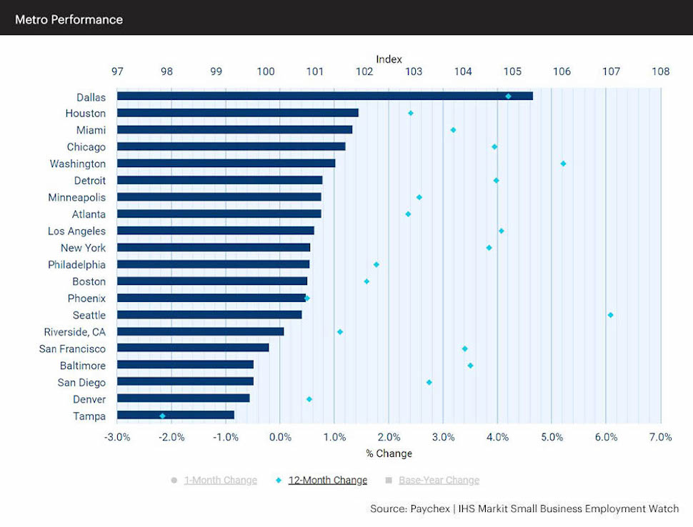
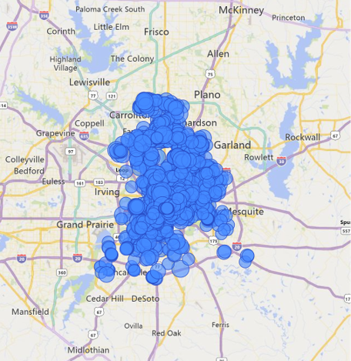
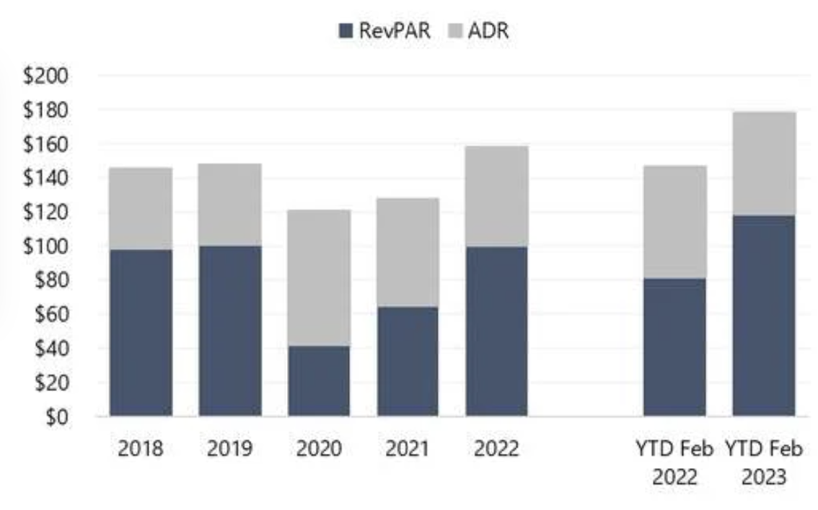

Why Dallas
Top Growing City in the US:
One of the four fastest-growing cities
Tourism Impact:
Tourism contributes ~ $7.2 billion.
Annual tourism ~ $200 million.
RevPAR Exceeds Pre-COVID Levels:
Fastest RevPAR recovery post-COVID.
Factors Driving Revenue Growth:
ADR Increase:
Strong demand from high-rated leisure travelers.
Expansion of upscale and luxury service accommodations.
Dallas overall Business Growth
Average Booked Days in Dallas
RevPAR and ADR of Dallas City
Source: https://www.hospitalitynet.org/opinion/4116241.html
Notes:
FOR OUR STUDY CONSIDERING DALLS HAS BEEN INPERATIVE As IT IS one of the fastest-growing cities in the U.S., WITH has a substantial tourism impact, contributing over $7.2 billion annually, with an additional $200 million in annual tourism. Dallas has experienced the fastest (revenue per available room) post-COVID. OTHER RESONS INCLUDE Average Daily Rate (ADR), catering to strong demand from high-rated leisure travelers and the expansion of upscale and luxury accommodations. These factors position Dallas as a lucrative market for your AIR BNB BUSSINESS GROWTH. These compelling factors position Dallas as a highly lucrative market for substantial Airbnb business growth. In our next slide, we'll delve into the data set, exploring key metrics that validate this promising opportunity.

Slide 5
Business Problem Identification and Recommendations
Revenue prediction for next quarter
Defining important parameters for upcoming period Revenue for a particular host
Cost Benefit analysis
Notes:
Based on accurate prediction model
Coeff's and important feature analysis
Which neighbourhood to focus on which feature, and which property type has to focus on which feature

Slide 6


Our Approach:
Exploratory Data Analysis
Model Selection
Interpretability
Ordinary Least Squares
Prediction Accuracy:
Random Forest
Gradient Boosting
Transformations
Cleaned Data
Feature Engineering
Airbnb Dataset
Data Cleaning
Interpretation and Insights
Optimal Revenue
Grid Search
Cost Benefit Analysis
Model Tuning
Testing and Application
Business Insights
Recommendations
Data Insights
Notes:
In our study, we began by collecting quarterly Airbnb data, delving into exploratory data analysis with key graphs. We addressed missing values, separated datasets for training and testing, and engineered features for our model selection. Three models were chosen for their balance between interpretability and accuracy. After model tuning and evaluation, we applied the models to predict revenue. Analyzing coefficients, we derived actionable insights. As we move forward, our focus shifts to cost-benefit analysis and providing strategic insights to hosts for revenue optimization across diverse categories and neighborhoods. This is just a brief introduction of our approach and we will be discussing it in detail in our coming slides.

Slide 7




Data Preprocessing steps and Transformations
Identifying Column Types:
Separation of the columns into numerical and categorical types
Dropping irrelevant Columns:
Multiple columns were dropped that were not relevant to our study
Handling Missing Values: -
Numerical Columns: Missing values in numerical columns are filled with their representative values.
Categorical Columns: Missing values in categorical columns are filled with the mode
Data Processing:
A new column named 'Prev Quarter' is created. For each row, if the 'Quarter' is 4, it sets 'Prev Quarter' to 1; otherwise, it decrements the 'Quarter' by 1.
Dropping Duplicate Rows: To avoid skewness in the data, duplicate rows are removed.
Data Transformation:
This 'Date 'column was converted to a 'DateTime' object and transformed into the 'Year’, 'Month’ & ‘Quarter' columns
Notes:
In our data analysis process, we've taken several important steps. We've filled in missing values in numerical columns and used the most common value for missing data in categorical columns. To ensure accurate results, we've removed duplicate rows and irrelevant columns. We've also added a new 'Prev Quarter' column based on the 'Quarter' column for added context. Lastly, we've transformed the 'Date' column, making it more useful by creating new 'Year,' 'Month,' and 'Quarter' columns. These steps have improved the quality and relevance of our data for analysis.

Slide 8
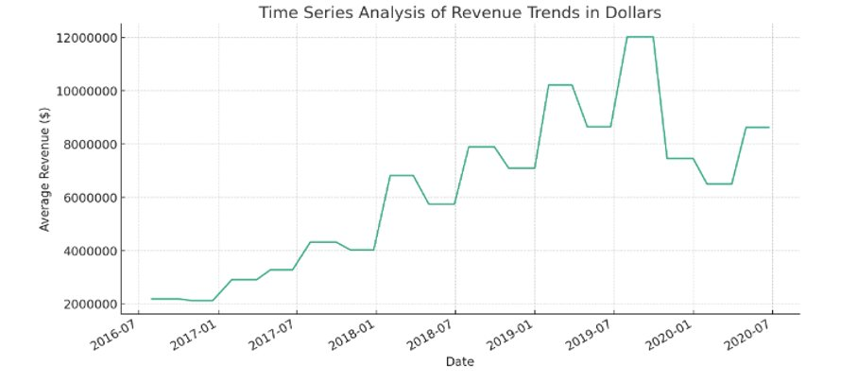
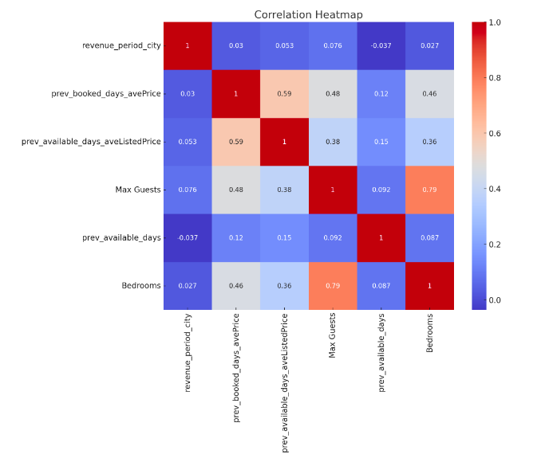
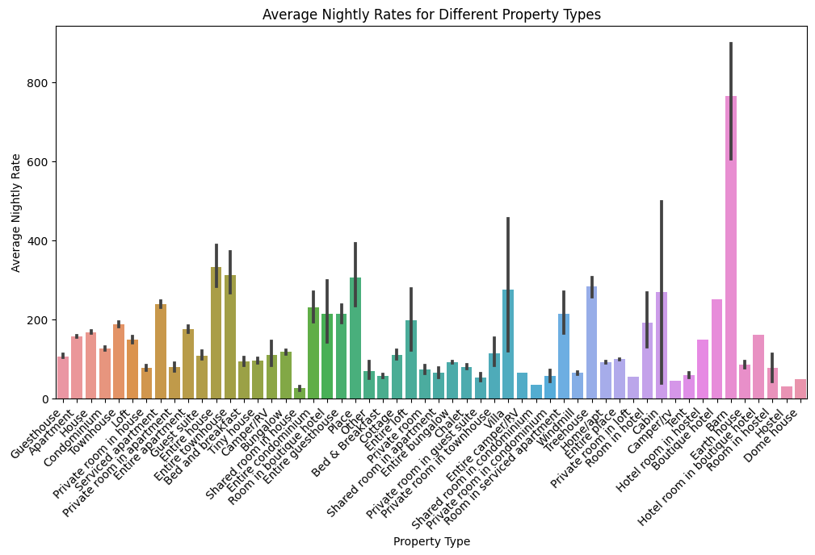
Exploratory Data Analysis (EDA)
Notes:
The heatmap shows the correlation between revenue and key variables such as average price for booked days, average listed price for available days, maximum guests, available days, and bedrooms

Slide 9
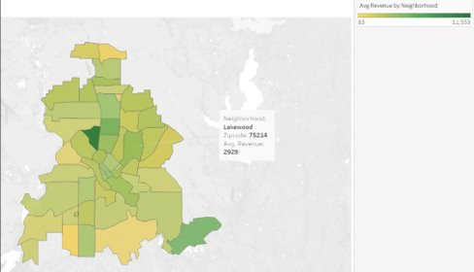
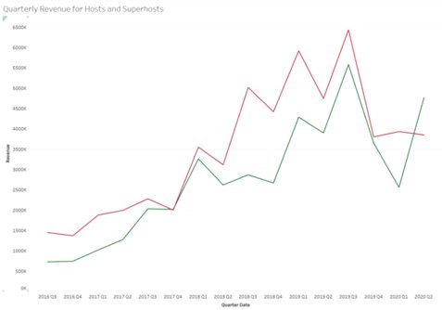
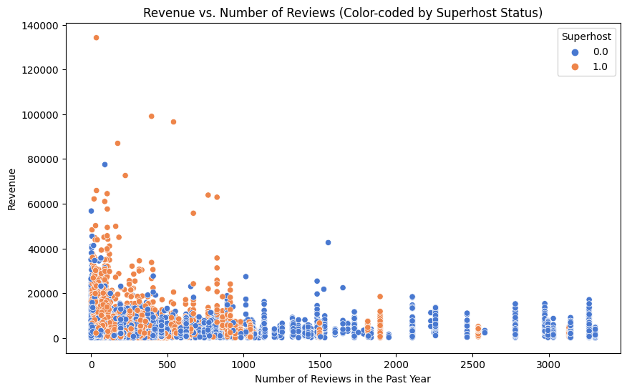
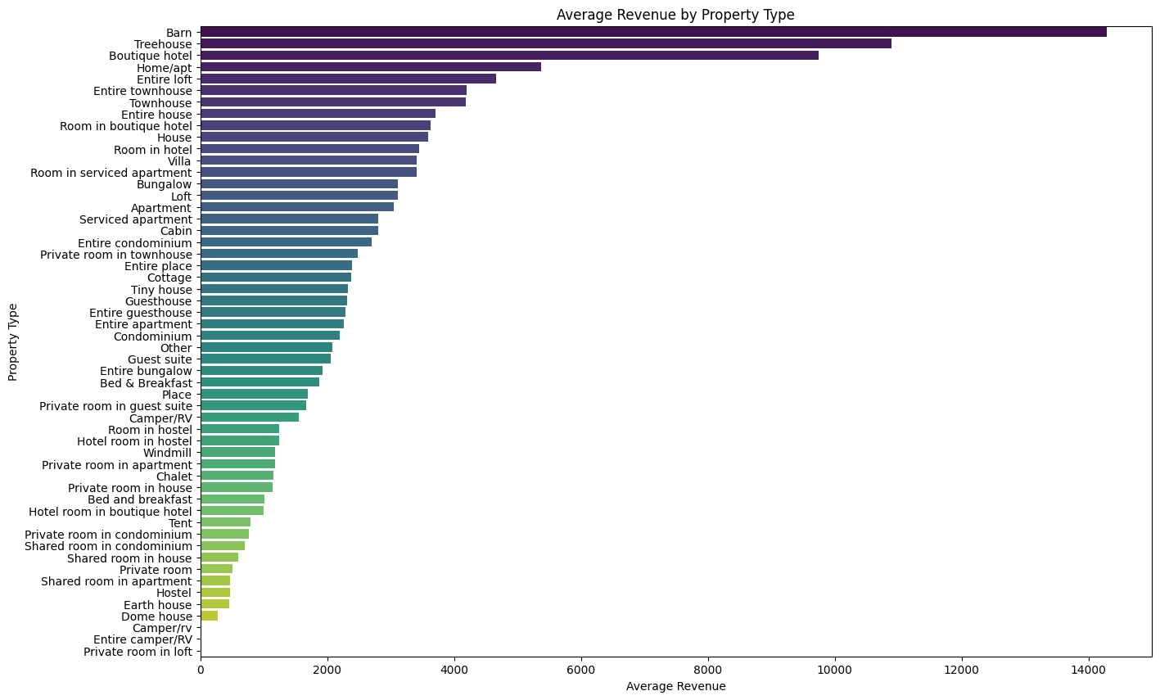
Exploratory Data Analysis (EDA)

Slide 10
Model Selection
Accuracy
Gradient Boost Regressor
Random forest
OLS Regression Backward
OLS Regression
R squared Validation | RMSE
99.35% | 2612.09
98.86% | 2865.05
71.68% | 3164.68
71.33% | 3330.17
Interpretability

Slide 11
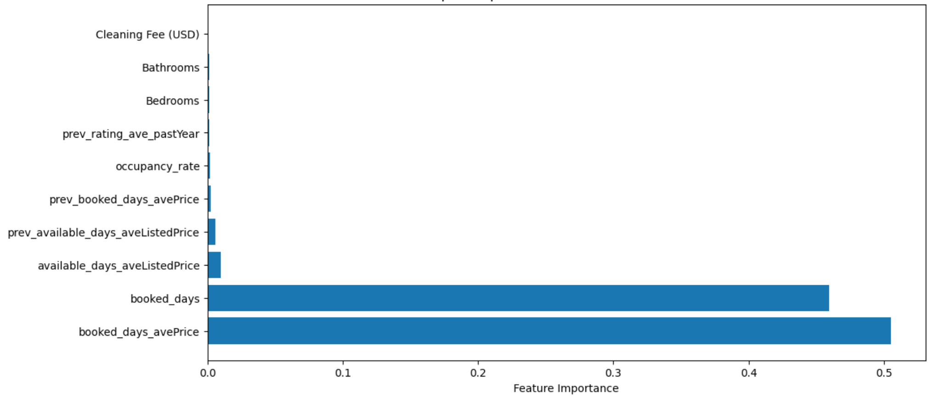

So, what does revenue depend on?
But isn't revenue the product of booked days and average Price?

Slide 12
Let's break it down
Revenue
Booked days
Occupancy Rate
Available Days
Booked Days Price
Occupanct Rate
Prev Avlbl Avg Listed Price
other features...
other features...

Slide 13
Feature Engineering & Feature Construction
Excluded Features:
host_is_superhost_in_period
available_days
available_days_aveListedPrice
booked_days
booked_days_avePrice
Instantbook Enabled
Nightly Rate
Number of Reviews
Rating Overall
occupancy_rate
Nightly Rate_tractQuartile
available_days_aveListedPrice_tractQuartile
tract_superhosts_ratio
tract_prev_superhosts
booked_days_period_city
revenue_period_city
tract_booking_share
tract_revenue_share
revenue
Feature Splitting
Process
Top Features to be considered in our analysis:
Previous Period Metrics:
prev_available_days
prev_booked_days_avePrice
prev_available_days_aveListedPrice
prev_booked_days
prev_Instantbook Enabled
Previous Year Metrics:
prev_hostResponseAverage_pastYear
prev_numReserv_pastYear
prev_hostResponseNumber_pastYear
prev_numReservedDays_pastYear
prev_rating_ave_pastYear
prev_num_5_star_Rev_pastYear
prev_numReviews_pastYear
Current metrics:
tract_housing_units
Bathrooms
Property Type_Room in boutique hotel
Bedrooms
tract_white_perc
Max Guests
tract_black_perc
Cleaning Fee (USD)
Previous period input features:
prev_available_days
prev_booked_days_avePrice
prev_avilable_days_aveListedPrice
Current amenities features:
tract_housing_units
Bathrooms
Property Type_Room in boutique hotel
Bedrooms
GB
RF
+
Added Interactive features:
Property_type* Neighborhood
Ratio : Bedroom/Bathroom
YoY growth rate
One hot encoding of nominal categorical features:
Property_type
Neighborhood
GB: Gradient Boosting
RF: Random Forest

Slide 14
MODEL TUNING: GB and RF
Tuning steps: Least MSE | Trees = 10 | 50 | 100 | 200 | 400
LR = 0.1, D = 2 | 5530431.41 | 722965.20 | 228545.16 | 126901.43 | 90032.78
LR = 0.1, D = 4 | 2578054.14 | 89443.97 | 74456.15 | 71948.38 | 67113.25
LR = 0.1, D = 6 | 2165479.41 | 95434.78 | 87806.87 | 83259.66 | 85828.80
LR = 0.05, D = 2 | 8389123.88 | 2249155.43 | 721805.76 | 212997.38 | 110490.22
LR = 0.05, D = 4 | 5973663.65 | 350856.99 | 85283.59 | 70061.52 | 60379.43
LR = 0.05, D = 6 | 5411453.41 | 251492.29 | 97004.17 | 73220.99 | 80683.23
By tuning the number of trees, depth, and learning rate, we find the Gradient Boosting model sweet spot that fits our data optimally.
In this case, we found the best model at:
No. Of Trees = 400
Depth = 4
Learning Rate = 0.05
Random Forest Summary:
No. Of Trees | MSE
100 | 202,688.41
200 | 201,543.19
300 | 202,415.59
400 | 200,593.38

Slide 15
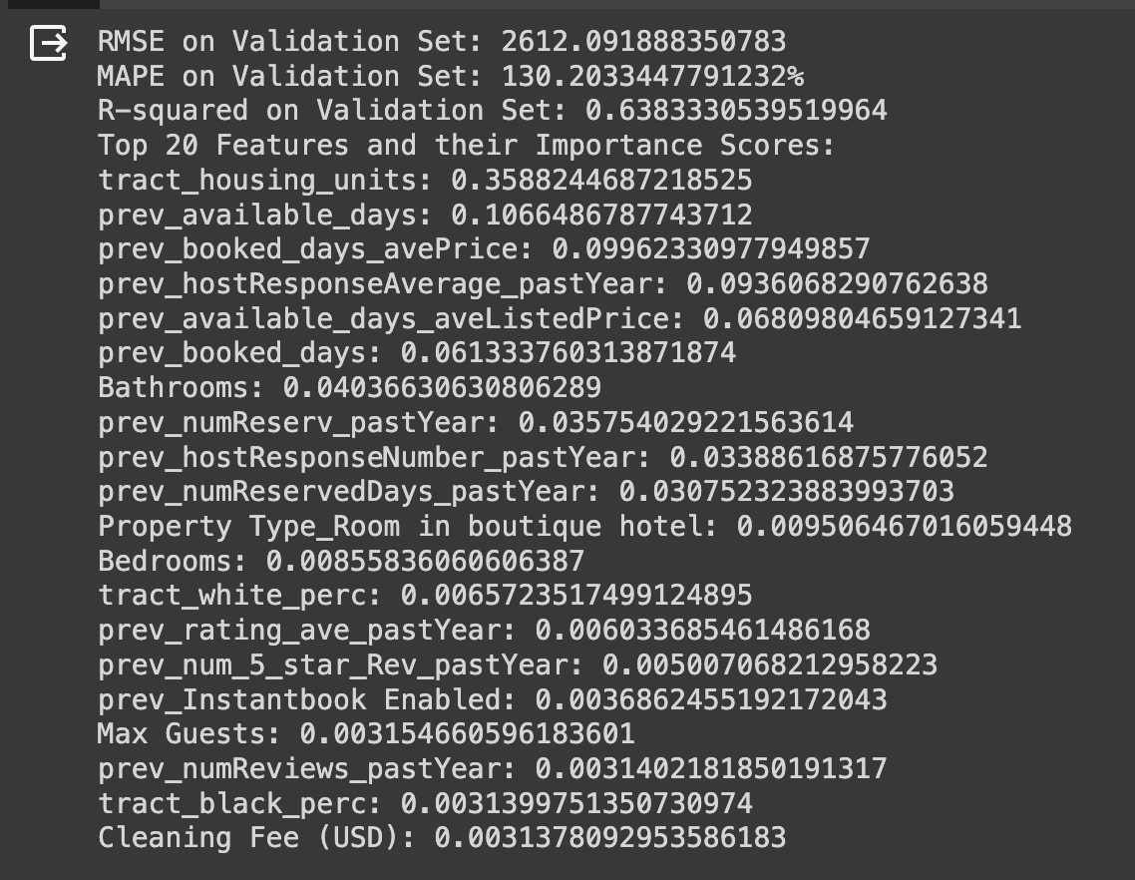
Top 20 Features and their importance
Excluded the variables that directly determine the revenue variable.
Only the past variables that could help predict future revenues were considered.
R-squared value was around 64%.
Used the data from July'16 to December'17 to predict the revenues for Jan' - Jun'18.

Slide 16

Backward Regression OLS: (Coefficients interpretation)
Positive Coefficients:
1. A significance p-value (p < 0.05) is considered
The calculated 'P value' indicated that the revenue of the boutique hotel is expected to be $1,423.9 higher than the baseline category
2. For every one-unit increase in the average rating from the previous year, the revenue is expected to increase by $711.4, holding all other variables constant.
Negative Coefficients:
"Room in hostel" has a coefficient of -1,134.7, indicating that being a room in a hostel is expected to decrease revenue by $1,134.7
Number of Top Features | Model Score (%)
10 | 68.29
20 | 71.17
25 | 71.01
30 | 70.68
50 | 69.61
70 | 69.39
90 | 69.48
Model Fit Statistics R-Square 0.7135 Adj R-Sq 0.7117 AIC 343869.9871 BIC 343873.8169 SBC 345006.9734 C(p) 142.0000

Slide 17
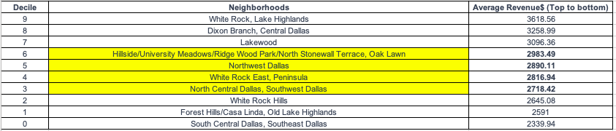
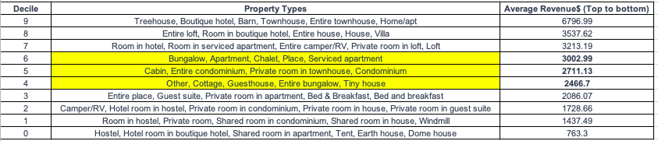
Decile charts on Natural segments

Slide 18
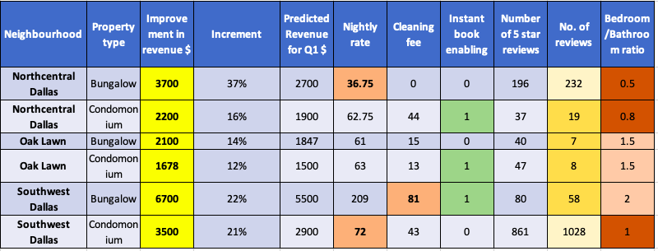
Natural segment level strategy

Slide 19
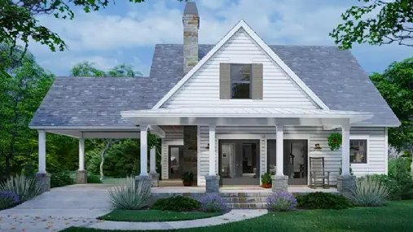
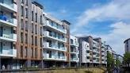
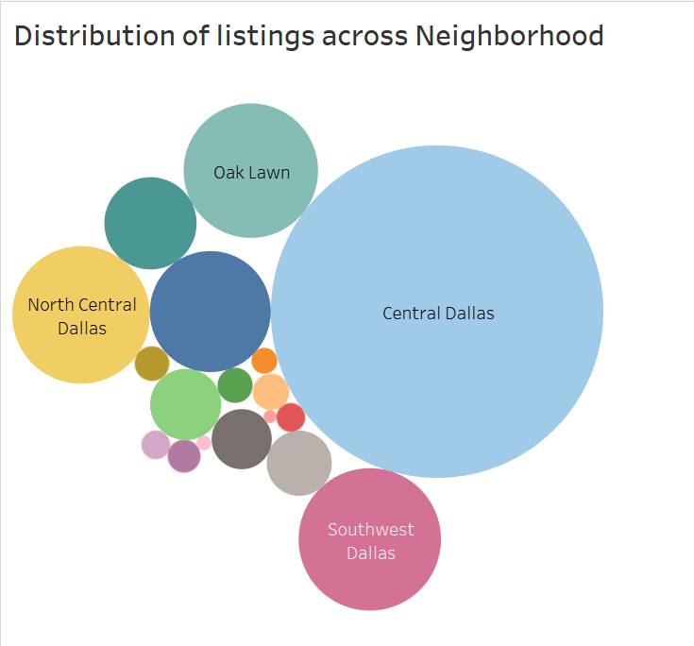
SEGMENT LEVEL STRATEGY
Bungalow
Condomonium
Southwest Dallas Condomonium focus parameters:
Bedroom to bathroom ratio improvement
Reasonable nightly rate
Northcentral Bungalow focus parameters:
Competitive nightly rate
Reduction of cleaning fee
Strong track record of reviews
Notes:
Condominium hotel means a building constructed, maintained, operated and managed as a hotel in which each room is separately rented

Slide 20

BUSINESS IMPACT
For the Host:
Informed Investment:
Focus investments wisely.
Dynamic Pricing:
Adjust prices strategically based on the predicted revenue trends, potentially increasing their earnings
Targeted Marketing:
Boost marketing where needed.
Quality Enhancement:
Invest in quality.
Operational Planning:
Prepare for demand.
For Airbnb:
Market Growth:
Benefits from host earnings.
Data-Driven Insights:
Identify trends, develop features.
Host Retention:
Increase host loyalty.
Guest Experience:
Enhance brand reputation.

Slide 21
Limitations
There is scope for improvement for our final model by tuning parameters and considering additional factors
We did not consider some accuracy to interpret the data better and provide business insights
We did not focus on the effect of demographic factors on the pricing & subsequent revenue of property, which may be studied in greater detail
In the data preprocessing stage, we handled missing data by inputting the mean for numerical and mode for categorical. This may have impacted the model performance as there were large chunks of missing data in many parameters
We did not consider external data to augment the provided dataset, which may impact model capability. Eg: a high crime rate in a particular neighborhood can bring down revenue

Slide 22
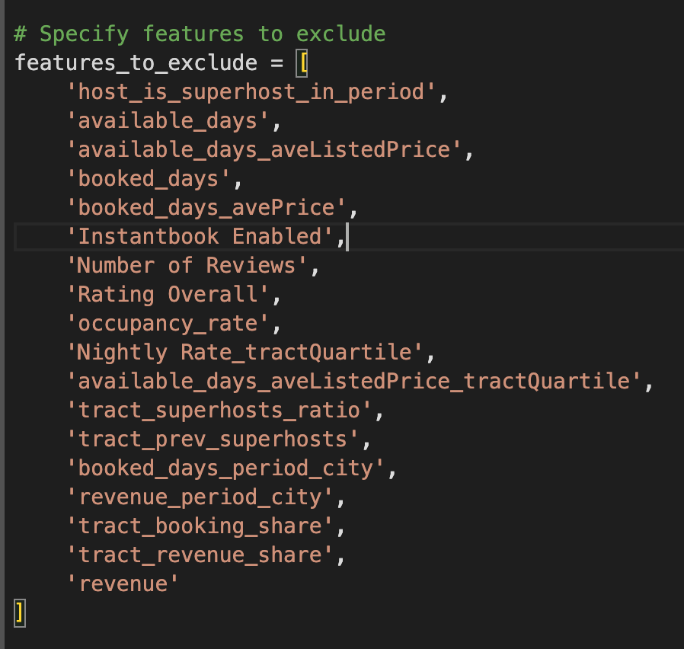
Appendix - Featured Excluded

Slide 23
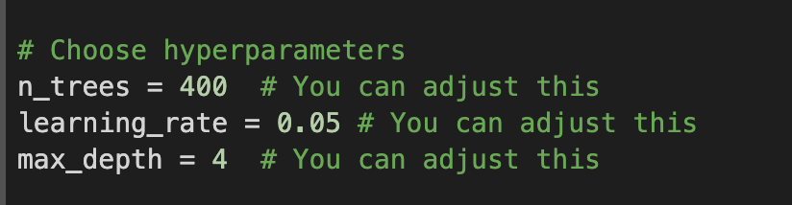
Appendix - Gradient Boosting Parameters

Slide 24
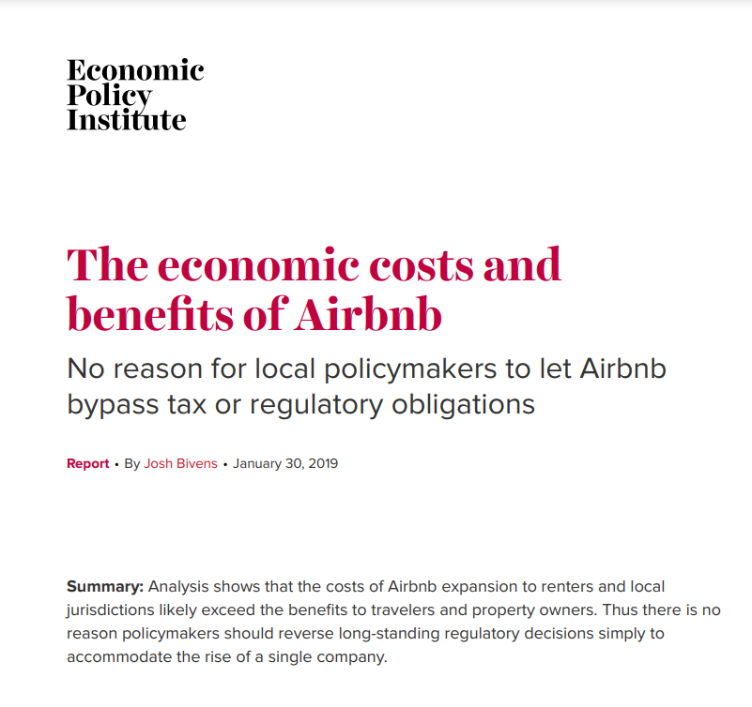
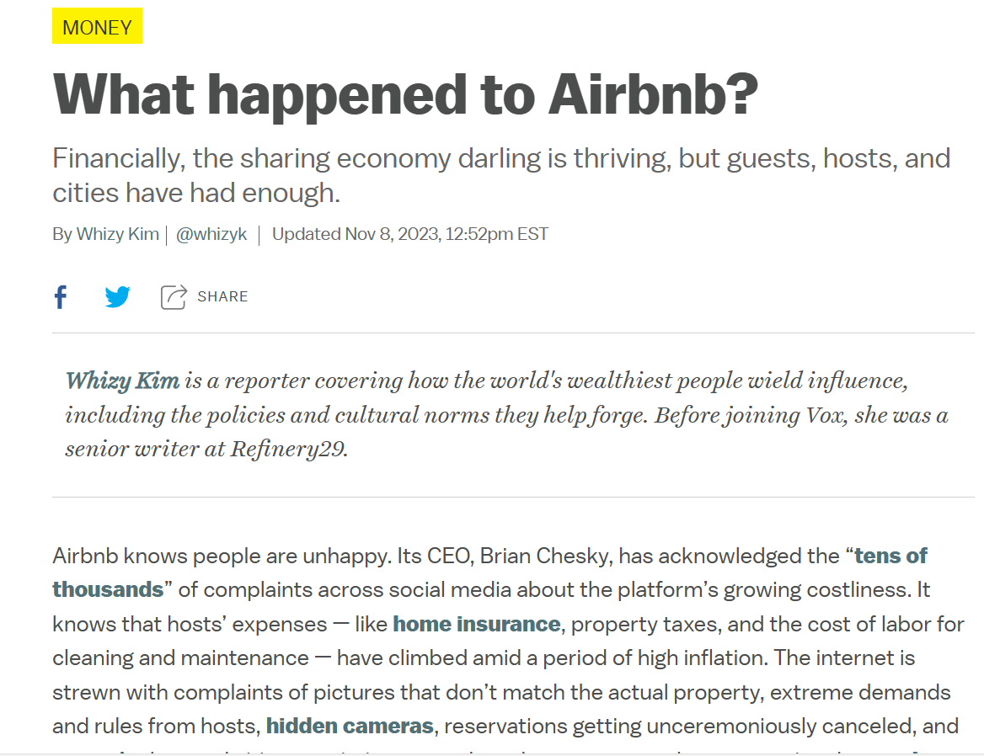
Articles
https://files.epi.org/pdf/157766.pdf
Airbnb vs hotels: Why are customers and hosts over Airbnb? - Vox

